Slide 1
Mid-project evaluation
G Chanikya,UG 3rd year, CSE
G Lohith Reddy,UG 3rd year, CSE
P Hemanth Naidu,UG 3rd year, CSE

Slide 2
Problem Statement
FNC-1 we have chosen the task of estimating the stance of a body text from a news article relative to a headline. Specifically, the body text may agree, disagree, discuss or be unrelated to the headlines.
Paper Link : https://arxiv.org/pdf/1712.03935v1.pdf

Slide 3
Input : A headline and a body text - either from the same news article or from two different articles.
Output : Classify the stance of the body text relative to the claim made in the headline into one of four categories:
Agrees: The body text agrees with the headline.
Disagrees: The body text disagrees with the headline.
Discusses: The body text discuss the same topic as the headline, but does not take a position.
Unrelated: The body text discusses a different topic than the headline.

Slide 4
Motivation
We want to make it easier to spot fake news by using different methods like computers, numbers, and external information. But not many studies have looked at all these methods together, so we need to see how they can work better when combined.

Slide 5
Literature Survey
The paper explores how combining different kinds of information, like patterns found in language, statistical data, and external context, can help better identify fake news. By using various features together, it aims to create a more effective system for telling real news from false information. This research could lead to improved ways of detecting fake news online.

Slide 6
Literature Survey-2
The new paper has more information from outside sources, like social media data, to improve how it spots fake news. It now works better by combining different types of clues, like language patterns and numbers, to tell real news apart from false stories. This update aims to make a stronger system for finding fake news online by using a wider range of information.

Slide 7
Plan
Explain the research plan(include details of implementation technique, model architecture, datasets, experiments you have selected for the project)
If required, you can split this slides content across multiple slides

Slide 8
Datasets
The data provided is (headline, body, stance) instances, where stance is one of {unrelated, discuss, agree, disagree}. The dataset is provided as two csv files. We can see them in the given link
Link: https://github.com/FakeNewsChallenge/fnc-1

Slide 9
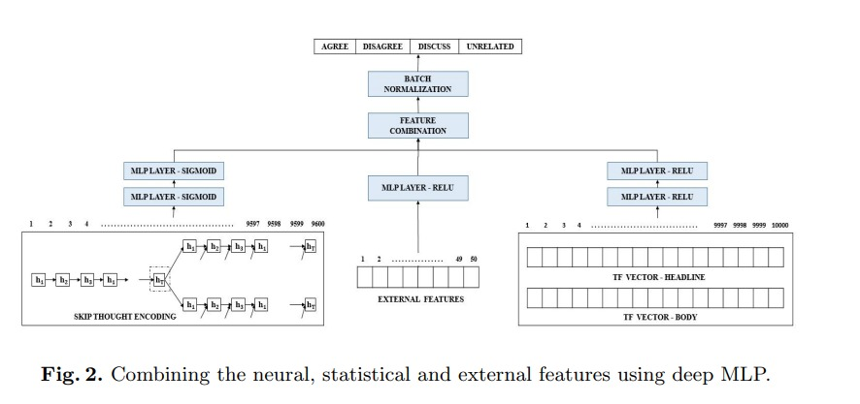
Model Architecture

Slide 10
Implementation
The FNC-1 dataset, used for analyzing news headlines and bodies, has a problem: there are more unrelated pairs than agree, disagree, or discuss pairs, making it unbalanced. This affects the performance of deep learning models. Additionally, certain words in news, like "crime" or "accident," signal negative tone. Detecting these nuances requires a huge training dataset, which FNC-1 lacks. To compensate, a simpler approach uses feature engineering and a neural network to evaluate each headline-body pair.

Slide 11
Implementation-2
We propose an approach that is based on the combination of statistical, neural and feature engineering heuristics which achieves state-of-the-art performance on the task of fake news identification.
We evaluate the proposed approach on FNC-1 challenge, and compare our results with the top-4 submissions to the challenge. We also analyze the applicability of several state-of-the-art deep models on FNC-1 dataset.

Slide 12
Statistical Features
We capture the statistical information from the text to vectors with the help of BOW, TF-IDF models.
We produce the following vectors for each headline-body pair
TF vector of the headline
TF vector of the body.
This gives us a vector of 5000 dimension each. We concatenate both of the TF vectors.

Slide 13
External Features
External features in text classification involve heuristics like word count, cosine similarity, and n-gram matching between headline and body.
Additional features include character and word n-gram matches (2 to 16 characters, 2 to 6 words).
Sentiment difference, or polarity, is computed using a lexicon-based approach for the headline-body pair.
A unique n-gram refuting feature is constructed using a Bag of Words (BOW) approach on a lexicon of predefined words and cosine similarities.

Slide 14
Neural Features
We used skip-thought module which encodes sentences to vector embedding of length 2400 each.
The skip-thought is a encoder-decoder based recurrent model that computes the relative occurrence of sentences.
We speculate that the features introduced by should be effective for stance detection as well. Given the skip-thought encoding of news and headline as u^news and v^head , we compute two features.

Slide 15
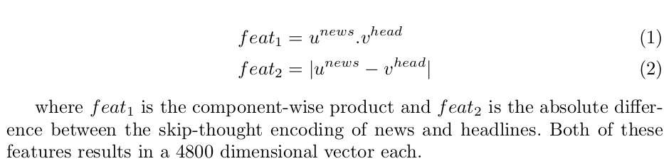

Slide 16
Model
The model computes the feature vectors separately and then combine these with the help of a MLP layer. We use cross-entropy as the loss function to optimize our architecture with a softmax layer at the output which classify the given headline-body pair into agree, disagree, discuss, and unrelated.

Slide 17
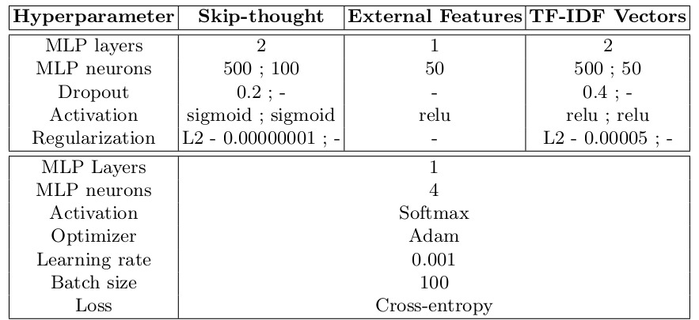

Slide 18
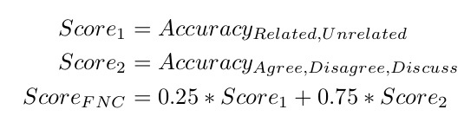
Metric Used
In the FNC-1 competition, they evaluate models by checking how well they decide if news is related or unrelated and if people agree, disagree, or discuss it. They use two scores, Score1 and Score2, for these tasks and combine them into a final Score(FNC), giving more importance to the second task. This combined score and class-wise accuracy are used to compare the performance of different techniques in the competition.

Slide 19
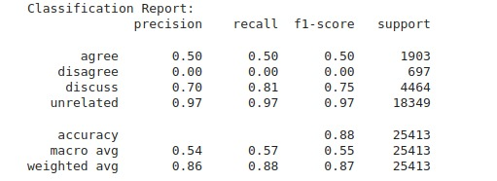
Analysis

Slide 20
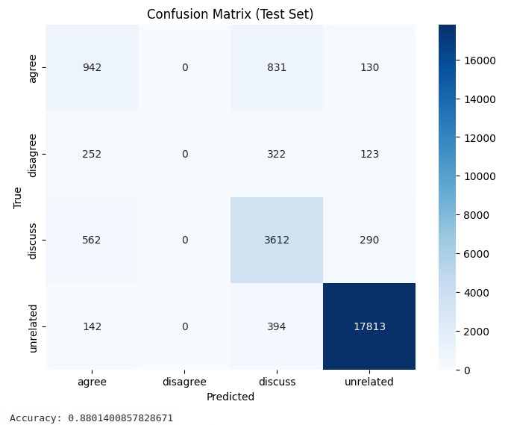

Slide 21
FNC Scores
Method | Score(FNC) | Agree | Disagree | Discuss | Unrelated | Overall
FNC-1 Baseline | 75.20 | 9.09 | 1.00 | 79.65 | 97.97 | 85.44
Word2Vec | 75.78 | 50.70 | 9.61 | 53.38 | 96.05 | 82.79
BiSkip | 76.18 | 31.8 | 0.00 | 81.20 | 91.18 | 82.48
CNN | 60.91 | 35.89 | 2.10 | 46.77 | 88.47 | 74.84
BiLSTM | 63.11 | 38.04 | 4.59 | 58.13 | 78.27 | 69.88
BiLSTM + Attention | 63.17 | 58.74 | 0.03 | 63.48 | 77.49 | 73.27
CNN + biLSTM | 64.95 | 74.09 | 2.46 | 57.85 | 74.87 | 72.89
Proposed | 83.08 | 49.50 | 0.50 | 80.91 | 97.01 | 88.01

Slide 22
Contributions
Statistical Features: G Chanikya
External features: P Hemanth Naidu
Neural Features: G Lohith Reddy
Model: Equal Contribution

